Slide 1
Computational Chemistry
Lecture 2: Hydrogen Atom and Variational Principle

Slide 2

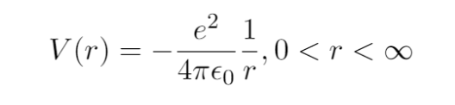
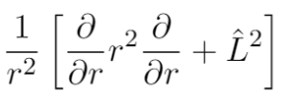
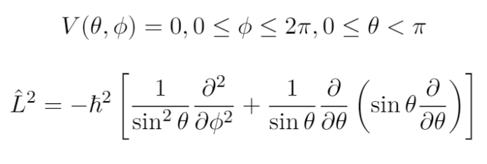
1. Hydrogen Atom
The simplest system: One proton, one electron, and the electrostatic (Coulomb) potential that holds them together.
H atom Schrödinger equation:
Coulomb potential:
The Laplacian: ,

Slide 3
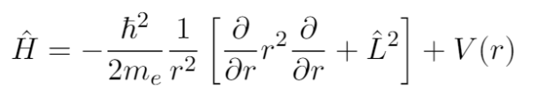

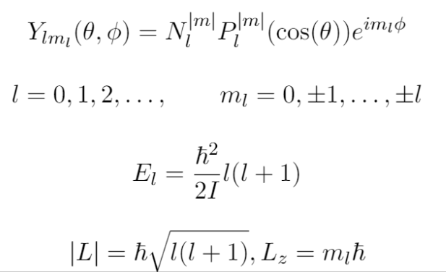

1. Hydrogen Atom
H atom Hamiltonian :
Separation of variables:
Angular component: Y_{l,ml} – spherical harmonic functions, describe angular motion/angular momentum of electron
Azimuthal quantum number: ,
Magnetic quantum number:
Angular momentum:

Slide 4
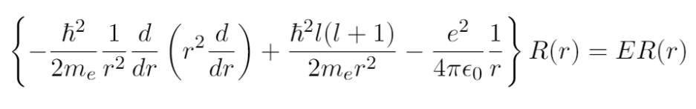
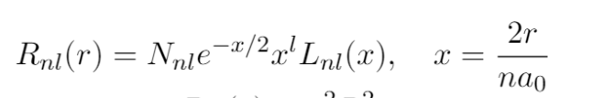
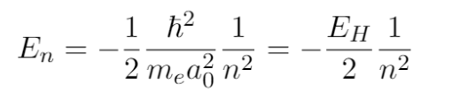

1. Hydrogen Atom
Radial component:
,

Slide 5

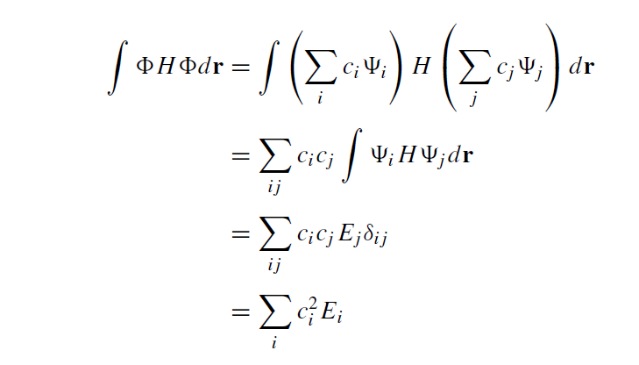
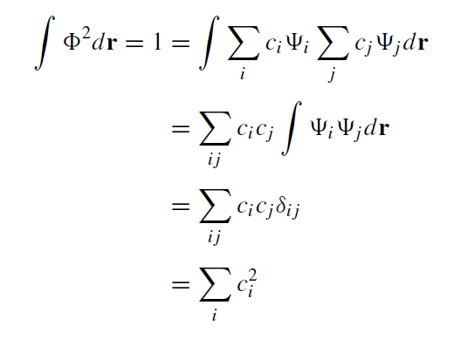
2. Variational Principle
Φ is some linear combination of Ψ_{i}
The normality of Φ
Evaluating the energy associated with wave function Φ

Slide 6
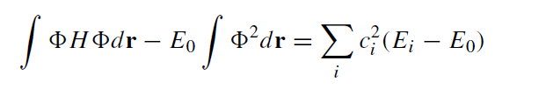
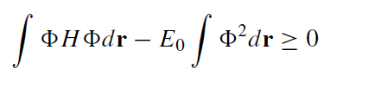
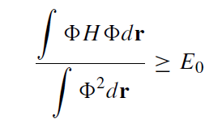
2. Variational Principle
In the set of all E_{i} there must be a lowest energy value E₀
we can judge the quality of wave functions
that we arbitrarily guess by their associated energies: the lower the better

Slide 7

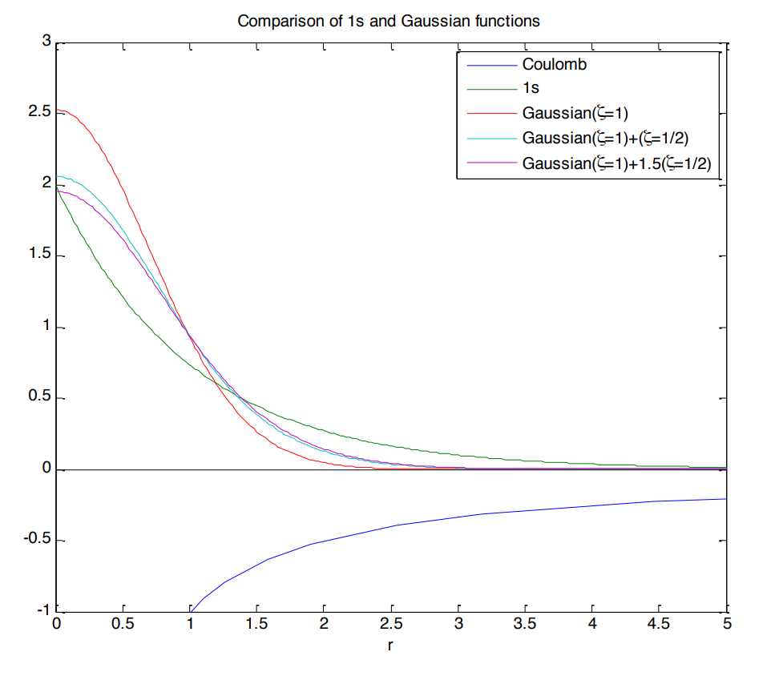
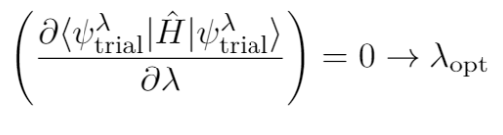
2. Variational Principle
Example: H atom 1s orbital
Construction of trial wave functions: linear combination of Gaussians:
E₀ = -0.5 Ha
E = -0.096 Ha
E = -0.306 Ha
E = -0.333 Ha
Optimize wavefunction with respect to vatiational parameter:

Slide 8
Summary
H atom: solving Schrödinger equation by separation of variables, quantum numbers, shapes of orbitals
Variational principle: we can use the calculus of variations to seek optimal wave functions

